Slide 1
MapReduce Paradigm
Module 3A – Introduction to MapReduce

Slide 2
OVERVIEW OF THE CHAPTER
MapReduce: The Map Tasks, Grouping by Key, The Reduce Tasks, Combiners, Details of MapReduce Execution, Coping With Node Failures.
Algorithms Using MapReduce:
Matrix-Vector Multiplication by MapReduce
Relational-Algebra Operations, Computing Selections by MapReduce, Computing Projections by MapReduce, Union, Intersection, and Difference by MapReduce, Computing Natural Join by MapReduce, Grouping and Aggregation by MapReduce
Matrix Multiplication, Matrix Multiplication with One MapReduce Step .
Illustrating use of MapReduce with use of real life databases and applications.

Slide 3
What Is Mapreduce In Hadoop?
MapReduce is a software framework and programming model used for processing huge amounts of data.
MapReduce program work in two phases, namely, Map and Reduce.
Map tasks deal with splitting and mapping of data while Reduce tasks shuffle and reduce the data.
Hadoop is capable of running MapReduce programs written in various languages: Java, Ruby, Python, and C++.
The programs of Map Reduce in cloud computing are parallel in nature, thus are very useful for performing large-scale data analysis using multiple machines in the cluster.

Slide 4
MapReduce Dean, J., & Ghemawat, S. (2004). “Mapreduce: Simplified Data Processing On Large Clusters”
MapReduce is a programming model and an associated implementation for processing and generating large data sets.
Users specify a Map function that processes a key/value pair to generate a set of intermediate key/value pairs
and a Reduce function that merges all intermediate values associated with the same intermediate key.
Many real world tasks are expressible in this model

Slide 5
MapReduce - Contd
Programs written in this functional style are automatically parallelized and executed on a large cluster of commodity machines.
The run-time system takes care of the details of
Partitioning the input data
Scheduling the program’s execution across a set of machines
Handling machine failures
Managing the required inter-machine communication.
This allows programmers without any experience with parallel and distributed systems to easily utilize the resources of a large distributed system.

Slide 6
MR- Programming Model
The computation takes a set of input key/value pairs, and produces a set of output key/value pairs.
The user expresses the computation as two functions: Map and Reduce.
Map, written by the user, takes an input pair & produces a set of intermediate key/value pairs.
The MapReduce library groups together all intermediate values with same intermediate key I and passes them to the Reduce function.
The Reduce function, also written by the user, accepts an intermediate key I and a set of values for that key.
It merges together these values to form a possibly smaller set of values.
Typically just zero or one output value is produced per Reduce invocation.
The intermediate values are supplied to the user’s Reduce function via an iterator. This allows us to handle lists of values that are too large to fit in memory.

Slide 7
MAP-REDUCE
Logical Functions : Mappers and Reducers
Developers write map and reducer functions then submit a jar to the Hadoop Cluster
Hadoop handles distributing the Map and Reduce tasks across the cluster
Typically Batch-Oriented

Slide 8
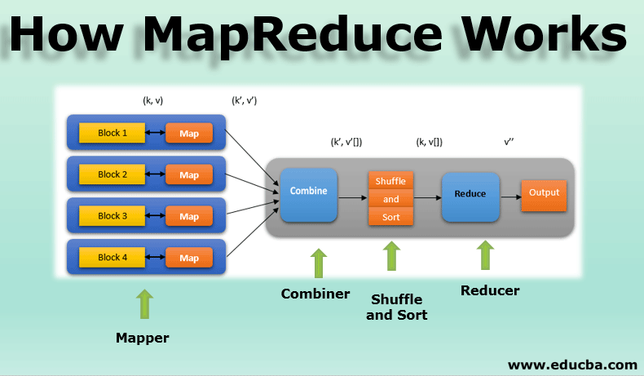

Slide 9
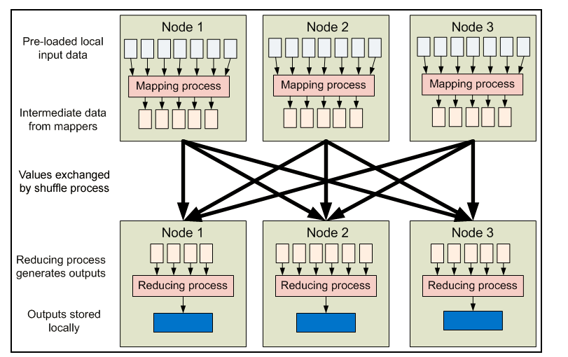
MAP-REDUCE JOB-FLOW

Slide 10
IDEA AND SOLUTION
Issue: Copying data over a network takes time
Idea:
Bring computation close to the data
Store files multiple times for reliability
Map-reduce addresses these problems
Google’s computational/data manipulation model
Elegant way to work with big data
Storage Infrastructure – File system
Google: GFS. Hadoop: HDFS
Programming model
Map-Reduce

Slide 11
MAPREDUCE: OVERVIEW
Sequentially read a lot of data
Map:
Extract something you care about
The basic unit of information, used in MapReduce is a (Key,value) pair. All types of structured and unstructured data need to be translated to this basic unit, before feeding the data to MapReduce model.
Group by key: Sort and Shuffle
Reduce:
Aggregate, summarize, filter or transform
Write the result
Outline stays the same, Map and Reduce change to fit the problem

Slide 12
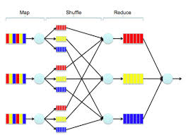
MR - ONE PICTURE

Slide 13
MORE SPECIFICALLY
Input: a set of key-value pairs
Programmer specifies two methods:
Map(k, v) → <k’, v’>*
Takes a key-value pair and outputs a set of key-value pairs
E.g., key is the filename, value is a single line in the file
There is one Map call for every (k,v) pair
Reduce(k’, <v’>*) → <k’, v’’>*
All values v’ with same key k’ are reduced together and processed in v’ order
There is one Reduce function call per unique key k’

Slide 14
WORD COUNT USING MAPREDUCE
map(key, value):
// key: document name; value: text of the document
for each word w in value:
emit(w, 1)
reduce(key, values):
// key: a word; value: an iterator over counts
result = 0
for each count v in values:
result += v
emit(key, result)

Slide 15
MAPREDUCE FOR BIG DATA
MapReduce logic, unlike other data frameworks, is not restricted to just structured datasets.
It has an extensive capability to handle unstructured data as well.
Map stage is the critical step which makes this possible.
Mapper brings a structure to unstructured data.
For instance, if U want to count the number of photographs on ur laptop by the location (city), where the photo was taken, U need to analyze unstructured data.
Mapper makes (key, value) pairs from this data set.
In this case, key will be the location and value will be the photograph.
After mapper is done with its task, we have a structure to the entire data-set.

Slide 16
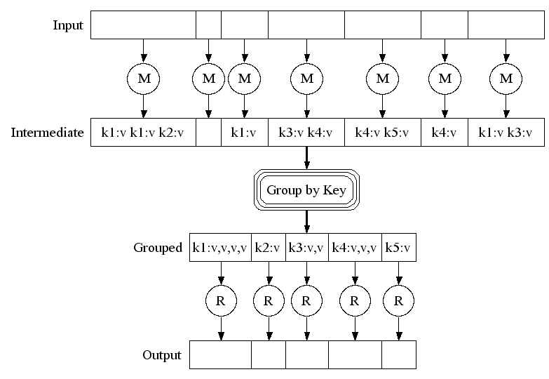
MAP-REDUCE: A DIAGRAM
Big document
MAP:
Read input and produces a set of key-value pairs
Group by key:
Collect all pairs with same key
(Hash merge, Shuffle, Sort, Partition)
Reduce:
Collect all values belonging to the key and output

Slide 17
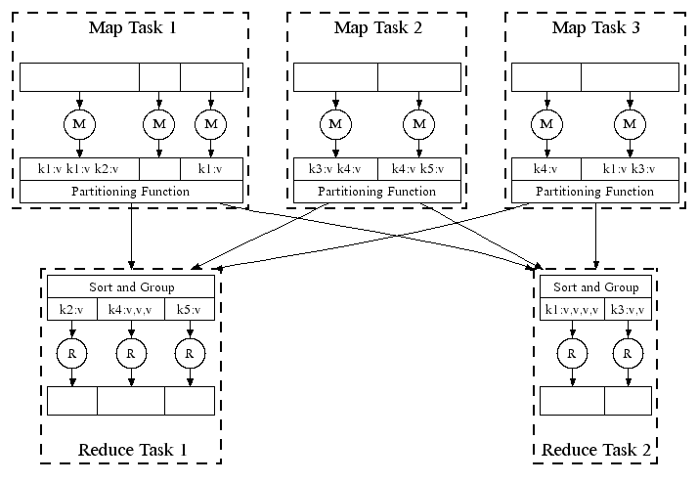
MAP-REDUCE: IN PARALLEL
All phases are distributed with many tasks doing the work

Slide 18
MAP-REDUCE
Programmer specifies:
Map, Reduce and input files
Workflow:
Read inputs as a set of key-value-pairs
Map transforms input kv-pairs into a new set of k'v'-pairs
Sorts & Shuffles the k'v'-pairs to output nodes
All k’v’-pairs with a given k’ are sent to the same reduce
Reduce processes all k'v'-pairs grouped by key into new k''v''-pairs
Write the resulting pairs to files
All phases are distributed with many tasks doing the work
Input 0
Input 1
Input 2
Map 0
Map 1
Map 2
Shuffle
Reduce 0
Reduce 1
Out 0
Out 1

Slide 19
MR- Execution Details
The complete execution process (execution of Map and Reduce tasks, both) is controlled by two types of entities called a
Jobtracker: Acts like a master (responsible for complete execution of submitted job)
Multiple Task Trackers: Acts like slaves, each of them performing the job
For every job submitted for execution in the system, there is one Jobtracker that resides on Namenode and there are multiple tasktrackers which reside on Datanode.

Slide 20
MapReduce Software Components
an input reader
a Map function
a partition function
a compare function
a Reduce function
an output writer

Slide 21
MR Software Components
Input reader
divides the input into appropriate size 'splits' and the framework assigns one split to each Map function.
reads data from stable storage (typically,distributed file system) and generates key/value pairs.
A common example will read a directory full of text files and return each line as a record.
Map function
takes a series of key/value pairs, processes each, and generates zero or more output key/value pairs.
The input and output types of the map can be (and often are) different from each other.
Eg: word count, the map function would break the line into words and output a key/value pair for each word.
Each output pair would contain the word as the key and no. of instances of that word in the line as the value.

Slide 22
Software Components- Partitioner
Each Map function output is allocated to a particular reducer by the application's partition function for sharding purposes.
The partition function is given the key and the number of reducers and returns the index of the desired reducer.
A typical default is to hash the key and use a uniformly distribute function to get the hash value modulo the number of reducers.
Between the map and reduce stages, the data are shuffled (parallel-sorted / exchanged between nodes) in order to move the data from the map node that produced them to the shard in which they will be reduced.
The shuffle can sometimes take longer than the computation time depending on network bandwidth, CPU speeds, data produced and time taken by map and reduce computations.

Slide 23
REFINEMENT: PARTITION FUNCTION
Want to control how keys get partitioned
Inputs to map tasks are created by contiguous splits of input file
Reduce needs to ensure that records with the same intermediate key end up at the same worker
System uses a default partition function:
hash(key) mod R
Sometimes useful to override the hash function:
E.g., hash(hostname(URL)) mod R ensures URLs from a host end up in the same output file

Slide 24
Why Do We Need A Partitioner
Even Distribution of Data: Partitioning ensures that data is evenly distributed across reducers, which can improve the performance of your MapReduce job.
Processing Specific Keys: Sometimes you may want to ensure that certain keys are processed by a specific reducer. For example, if you are processing sales data, you may want to ensure that all sales for a specific region are processed by the same reducer.
Reducing Network Overhead: When the output of a mapper is not partitioned, all keys are sent to all reducers. This can result in a lot of unnecessary network traffic and can slow down processing times. Partitioning can help reduce network overhead by ensuring that each reducer only receives the keys it needs to process

Slide 25
PARTITIONER
A partitioner works like a condition in processing an input dataset.
The partition phase takes place after the Map phase and before the Reduce phase.
A partitioner partitions the key-value pairs of intermediate Map-outputs.
It partitions the data using a user-defined condition, which works like a hash function.
The total number of partitions is same as the number of Reducer tasks for the job. Let us take an example to understand how the partitioner works.

Slide 26
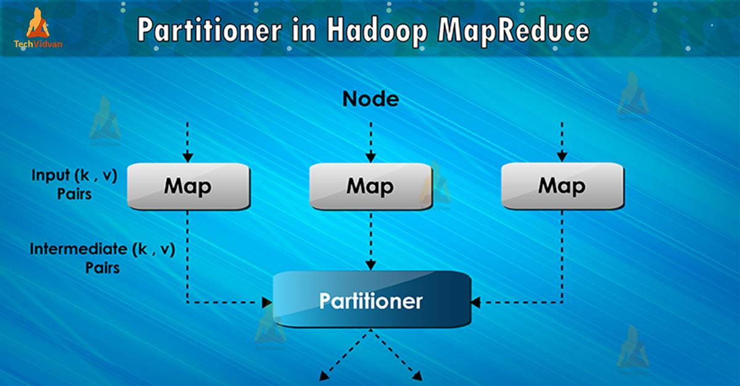
Partitioner in MapReduce job execution controls the partitioning of the keys of the intermediate map-outputs.
With the help of hash function, key (or a subset of the key) derives the partition.
The total number of partitions is equal to the number of reduce tasks.
On the basis of key value, framework partitions, each mapper output.
Records as having the same key value go into the same partition (within each mapper).
Then each partition is sent to a reducer. Partition class decides which partition a given (key, value) pair will go.
Partition phase in MapReduce data flow takes place after map phase and before reduce phase.
Poor partitioning of data means that some reducers will have more data input as compared to other.

Slide 27
MAP TASK
Map
Input − The key would be a pattern such as “any special key + filename + line number” (example: key = @input1) and the value would be the data in that line (eg: value = 1201 \t gopal \t 45 \t Male \t 50000).
Read the value (record data), which comes as input value from the argument list in a string.
Using the split function, separate the gender and store in a string variable.
Send the gender information and the record data value as output key-value pair from the map task to the partition task.
Output
You will get the gender data and the record data value as key-value pairs.

Slide 28
Partitioner Task
partitioner task accepts key-value pairs from the map task as its input.
According to the given conditional criteria of partitions, the input key-value paired data can be divided into three parts based on the age criteria.
Input − The whole data in a collection of key-value pairs.
key = Gender field value in the record.
value = Whole record data value of that gender.
Method − The process of partition logic runs as follows.
Read the age field value from the input key-value pair.
Check the age value with the following conditions.
Age less than or equal to 20
Age Greater than 20 and Less than or equal to 30.
Age Greater than 30.
Output − The whole data of key-value pairs are segmented into three collections of key-value pairs. The Reducer works individually on each collection.

Slide 29
Reduce Task
The number of partitioner tasks is equal to the number of reducer tasks.
Hence we have three Reducer tasks to be executed.
Input − The Reducer will execute three times with different collection of key-value pairs.
key = gender field value in the record.
value = the whole record data of that gender.
Method − The following logic will be applied on each collection.
Read the Salary field value of each record.
Check the salary with the max variable. If is the max salary, then assign this to max, otherwise skip
Repeat Steps for each key collection (Male & Female are the key collections).
After executing these three steps, you will find one max salary from the Male key collection and one max salary from the Female key collection.

Slide 30
MAPPER
void map(K1 key,
V1 value,
OutputCollector<K2, V2> output,
Reporter reporter)
K types implement WritableComparable
V types implement Writable

Slide 31
PARTITIONER
int getPartition(key, val, numPartitions)
Outputs the partition number for a given key
One partition == values sent to one Reduce task
HashPartitioner used by default
Uses key.hashCode() to return partition num
JobConf sets Partitioner implementation

Slide 32
REDUCTION
reduce( K2 key,
Iterator<V2> values,
OutputCollector<K3, V3> output,
Reporter reporter )
Keys & values sent to one partition all go to the same reduce task
Calls are sorted by key – “earlier” keys are reduced and output before “later” keys

Slide 33
MAPREDUCE ADVANTAGES
Automatic Parallelization:
Depending on the size of RAW INPUT DATA 🡺 instantiate multiple MAP tasks
Similarly, depending upon the number of intermediate <key, value> partitions 🡺 instantiate multiple REDUCE tasks
Run-time:
Data partitioning
Task scheduling
Handling machine failures
Managing inter-machine communication
Completely transparent to the programmer/ analyst/ user

Slide 34
Disadvantages
Real-time processing.
It's not always very easy to implement each and everything as a MR program. A lot of manual coding is required, even for common operations such as join, filter, projection, aggregates, sorting, distinct...
Semantics are hidden inside the map and reduce functions, so it is difficult to maintain, extend and optimize them
When your intermediate processes need to talk to each other(jobs run in isolation).
When your processing requires lot of data to be shuffled over the network.
When you need to handle streaming data. MR is best suited to batch process huge amounts of data which you already have with you.
When you can get the desired result with a standalone system.
When you have OLTP needs. MR is not suitable for a large number of short on-line transactions.

